Slide 1
CS310 Operating Systems Lecture 29: Deadlock - Introduction
Ravi Mittal
IIT Goa

Slide 2
Acknowledgements !
Contents of this class presentation has been taken from various sources. Thanks are due to the original content creators:
CS162, Operating System and Systems Programming, University of California, Berkeley
Book: Operating Systems: Principles and Practice: Thomas Anderson and Michael Dahlin, Volume II
Chapter 5.6
CS4410: Operating Systems, 2019sp, Slides - Deadlock

Slide 3
Reading
Book: Operating Systems: Principles and Practice: Thomas Anderson and Michael Dahlin, Volume II, Chapter 6.5
Book: Operating System Concepts, 10th Edition, by Silberschatz, Galvin, and Gagne
CS4410: Operating Systems, 2019sp, Slides - Deadlock

Slide 4
Today, we will study
What is deadlock?
Why deadlock?
Conditions for a deadlock
Detecting a deadlock

Slide 5
What is a Deadlock?

Slide 6
Ensuring Progress
Liveness:
A set of properties that a system must satisfy to ensure that processes make progress during their execution life cycle
Deadlock and Starvation are both liveness concerns
Starvation: thread fails to make progress for an indefinite period of time
Causes of starvation:
Scheduling policy never runs a particular thread on the CPU
Threads wait for each other or are spinning in a way that will never be resolved
Kumar CS 162 at UC Berkeley, Summer 2020

Slide 7
Deadlock: A Type of Starvation
Starvation – thread fails to make progress for an indefinite period of time
Deadlock – starvation due to a cycle of waiting among a set of threads
Each thread waits for some other thread in the cycle to take some action
Deadlock implies starvation (example: dinning philosophers)
Starvation does not imply deadlock
Thread
A
Owned
By
Wait
For
Res 1
Res 2
Wait
For
Thread
B
Owned
By
Kumar CS 162 at UC Berkeley, Summer 2020

Slide 8
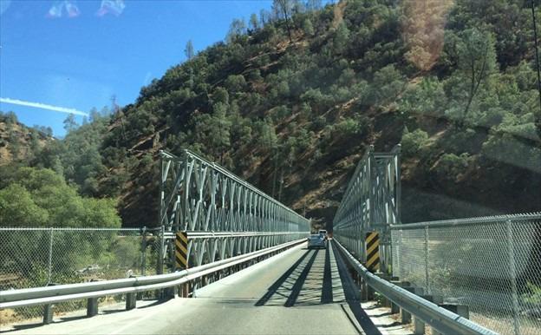
Example: Single-Lane Bridge Crossing
Kumar CS 162 at UC Berkeley, Summer 2020

Slide 9
Bridge Crossing Example
Honk!
Each segment of road can be viewed as a resource
Car must own the segment under them
Must acquire segment that they are moving into
Deadlock: Two cars in opposite directions meet in middle
Starvation (not deadlock): Eastbound traffic doesn’t stop for westbound traffic
Kumar CS 162 at UC Berkeley, Summer 2020

Slide 10
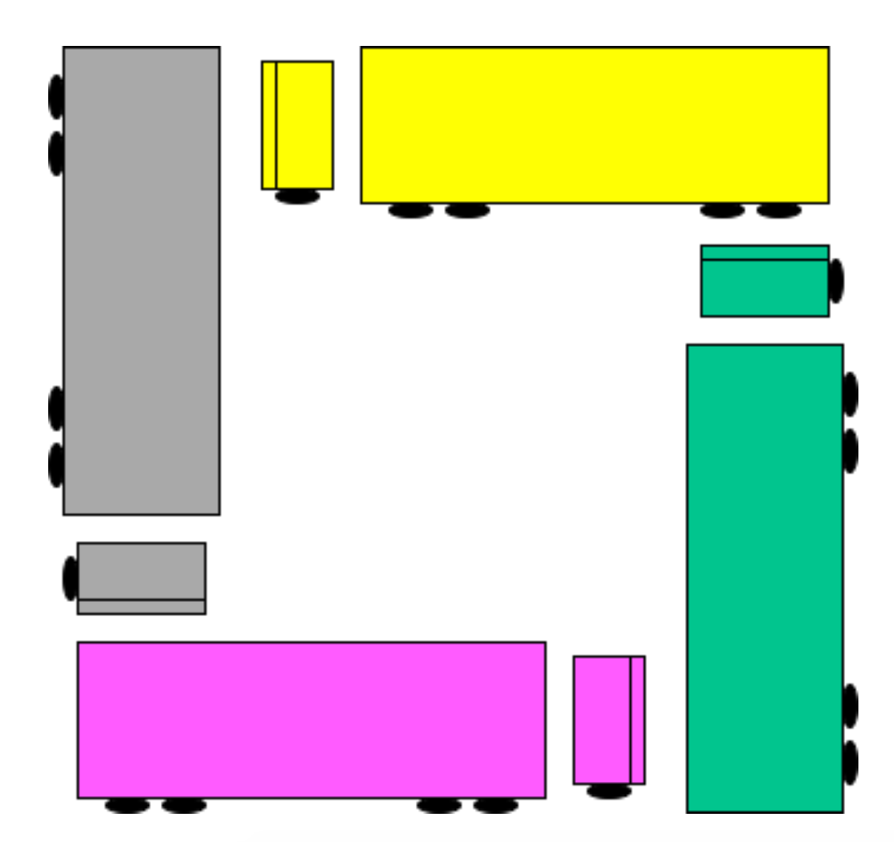
Is this a deadlock?

Slide 11
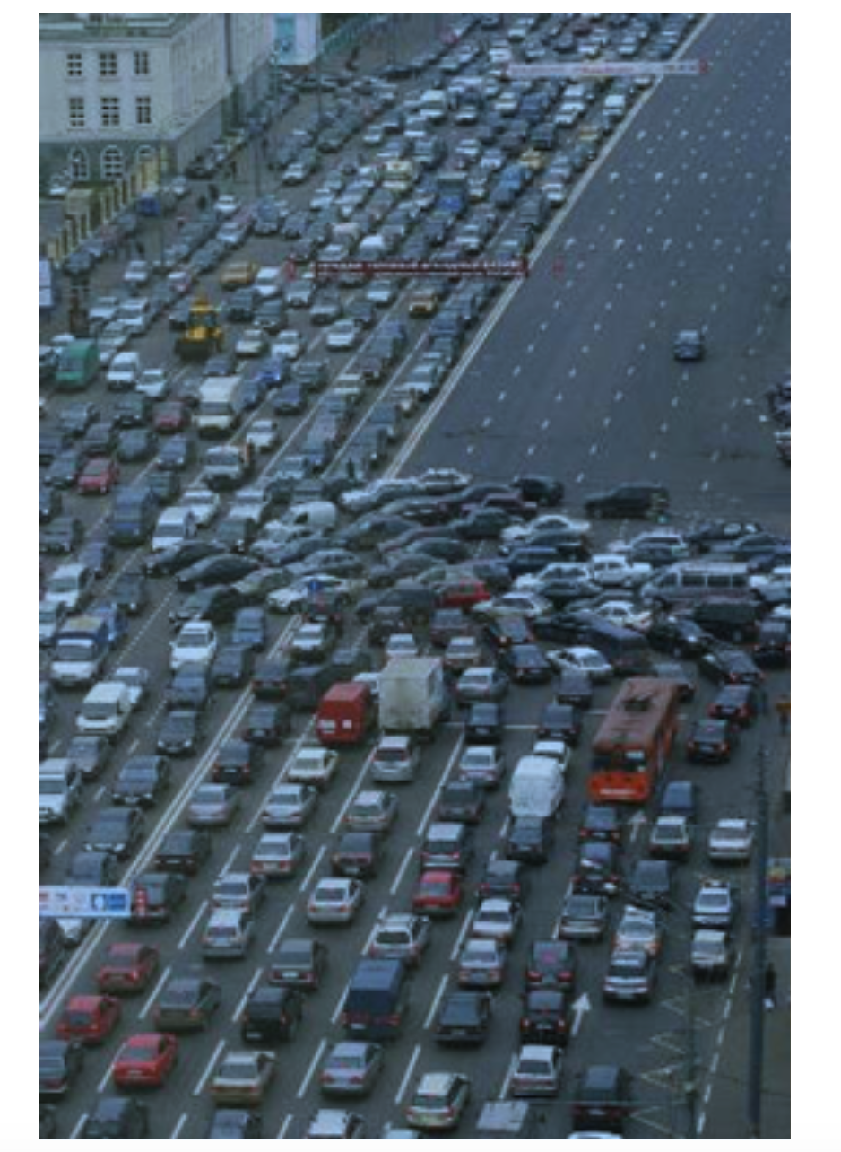
Is this a deadlock?

Slide 12
Why Deadlock?

Slide 13
Deadlock with Locks
Thread A
x.Acquire();
y.Acquire();
…
y.Release();
x.Release();
Thread B
y.Acquire();
x.Acquire();
…
x.Release();
y.Release();
Thread
A
Owned
By
Wait
For
Lock x
Lock y
Nondeterministic Deadlock
Wait
For
Thread
B
Owned
By
Kumar CS 162 at UC Berkeley, Summer 2020

Slide 14
Deadlock with Locks: Unlucky Case
Thread A
x.Acquire();
y.Acquire(); <stalled>
<unreachable>
…
y.Release();
x.Release();
Thread B
y.Acquire();
x.Acquire(); <stalled>
<unreachable>
…
x.Release();
y.Release();
Thread
A
Owned
By
Wait
For
Lock x
Lock y
Wait
For
Thread
B
Owned
By
Kumar CS 162 at UC Berkeley, Summer 2020

Slide 15
Deadlock with Locks: Lucky Case
Sometimes, schedule won’t trigger deadlock
Thread A
x.Acquire();
y.Acquire();
…
y.Release();
x.Release();
Thread B
y.Acquire();
x.Acquire();
…
x.Release();
y.Release();
Thread
A
Owned
By
Wait
For
Lock x
Lock y
Wait
For
Thread
B
Owned
By
Kumar CS 162 at UC Berkeley, Summer 2020

Slide 16
Other Types of Deadlock
Threads often block waiting for resources
Locks
Terminals
Printers
CD drives
Memory
Threads often block waiting for other thread

Slide 17
Deadlock with Space
Thread A
AllocateOrWait(1 MB)
AllocateOrWait(1 MB)
Free(1 MB)
Free(1 MB)
Thread B
AllocateOrWait(1 MB)
AllocateOrWait(1 MB)
Free(1 MB)
Free(1 MB)
If only 2 MB of space, we can get in to deadlock situation
Kumar CS 162 at UC Berkeley, Summer 2020

Slide 18
Deadlock happens sometimes
A system may be live without starvation or deadlock for most of the time
However, a particular workload or unlucky interleaving may cause starvation or deadlock
Example: Dining philosophers may succeed in eating for a long time before hitting the unlucky sequence of events that causes them to deadlock.
Testing may not discover problems. Hence, it is important to design a system that is deadlock free

Slide 19
Conditions for a Deadlock !

Slide 20
Necessary Conditions for Deadlock
There are 4 necessary conditions for deadlock to occur
If you can prevent any one of these conditions, you can eliminate the possibility of deadlock
Bounded Resources
There are a finite number of threads that can simultaneously use a resource
No preemption
Once a thread acquires a resource, its ownership cannot be revoked until the thread acts to release it
Wait while Holding
A thread holds one resource while waiting for another
Also called multiple independent requests
Circular Waiting
A set of waiting threads such that each thread is waiting for a resource held by another
Book: OS : Anderson and Dahlin

Slide 21
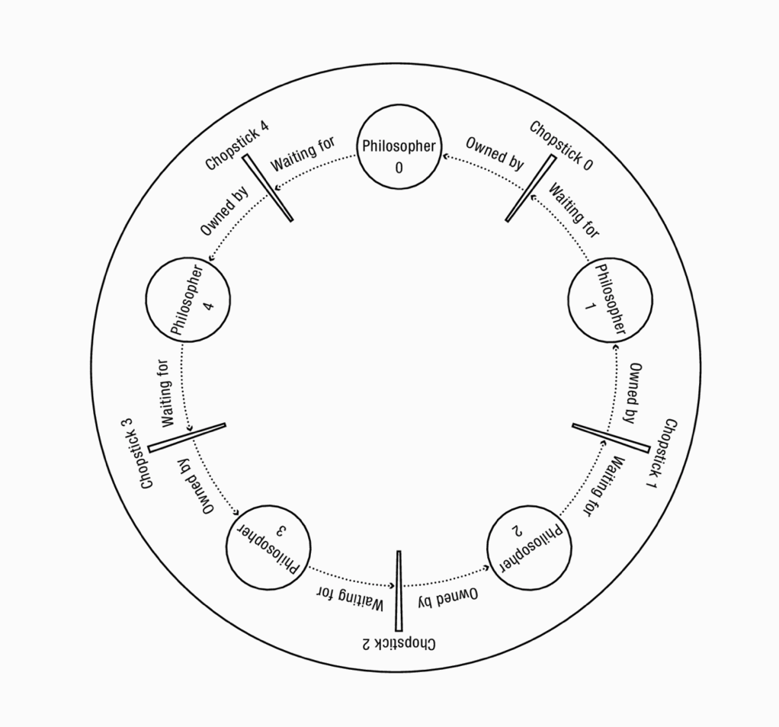
Case: Dinning Philosopher Problem
Thread shown as a Circle
Resource is shown as a rectangle
Arrow shows relationship
Book: OS : Anderson and Dahlin

Slide 22
Case: Dinning Philosopher Problem
Bounded Resources
Each chopstick can be held by a single philosopher at a time
No preemption
Once a philosopher picks up a chopstick, she does not release it until she is done eating even it means no one will ever eat
Wait while holding
When a philosopher needs to wait for a chopstick, she continues to hold onto any chopstick she has already picked up
Circular Waiting
In mapped abstract graph, we can see circular waiting
Thread shown as a Circle
Resource is shown as a rectangle
Arrow shows relationship
Book: OS : Anderson and Dahlin

Slide 23
Case: Dinning Philosopher Problem
Four conditions are necessary but not sufficient for deadlock
If there are multiple instances of a type of resource, there can be cycle of waiting without deadlock
A thread not in cycle may return resource that enables a waiting thread to proceed
Book: OS : Anderson and Dahlin

Slide 24
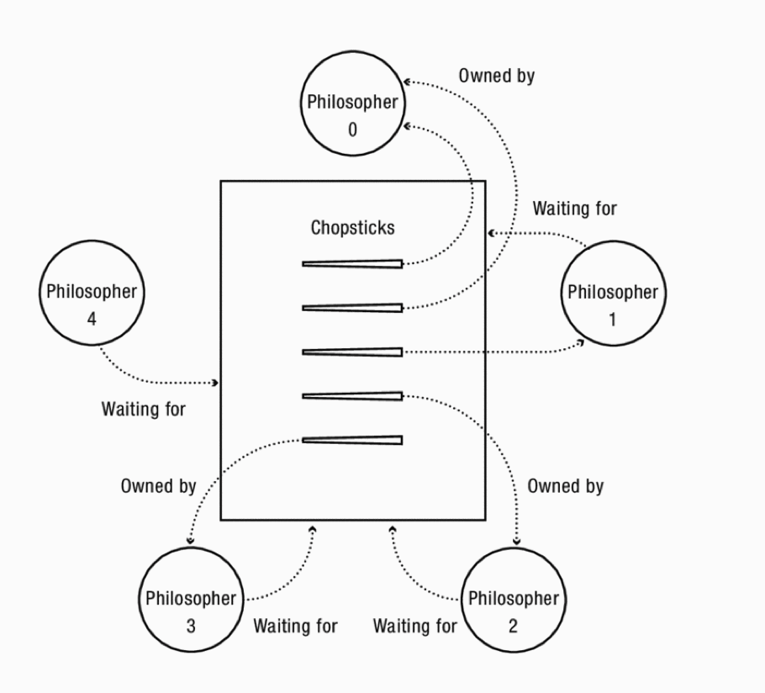
No deadlock
Book: OS : Anderson and Dahlin

Slide 25
No deadlock
Philosopher 0 is with two chopsticks
Philosophers 1, 2,3 : each as one chopstick
Philosopher 4 doesn’t have any chopstick
Bounded resources – 5 chopsticks
No preemption – can’t forcibly take chopstick away from philosopher’s hand
Wait while holding – philosophers 2, 3, 4 are holding chopsticks while waiting for another
Circular Waiting - each of philosophers 2, 3, and 4 are waiting for a resource held by another of them
Eventually, philosopher 1 will release it’s two chopsticks
Will allow philosopher 2 and 3 to eat and release chopsticks
Now philosophers 4 and 5 can eat
Book: OS : Anderson and Dahlin

Slide 26
Detecting a Deadlock

Slide 27
Simple Deadlock detection mechanism
Deadlock detection mechanisms must be simple
Even if it leads to occasional false positive
A program can choose to wait only briefly before declaring that recovery is needed

Slide 28
Deadlock Detection – Simple approaches
PSTN Networks: When making an International call (or local call), resources on the path are booked.
When unable to find a free circuit on the next hop – it cancels connection attempt and sends a message “all lines on the path are busy. Try after some time”
Internet: When a router is overloaded it runs out of packet buffers – drops incoming packets
Alternative would be each router to wait to send a packet until it knows that the next router has space – could lead to deadlock – Identifying a deadlock would be expensive and time consuming instead of dropping packets

Slide 29
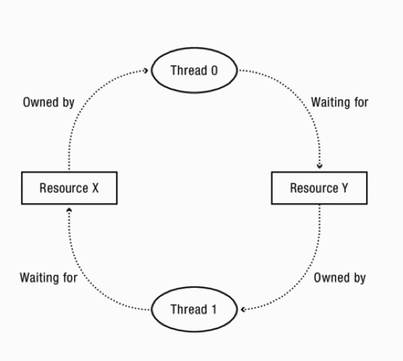
Analyzing - Resource Allocation Graph (RAG)
Consider several resources and only one thread can hold each resource at a time
Example: resources – one printer, one keyboard, one speaker
We can detect a deadlock by analyzing simple graph

Slide 30
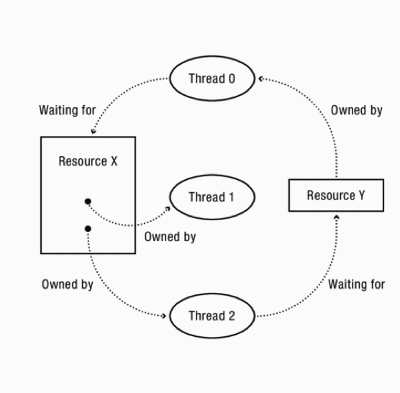
Multiple instances of one resource
Multiple instances of a resource can be represented as a resource with k interchangeable instances
Eg K equivalent printers as a node with k connections
Cycle is necessary but not sufficient condition for deadlock

Slide 31
Resource-Allocation Graph Examples
R₁
R₂
R₁
R₂
Model: Directed Graph
request edge
T_{i} → R_{j}
assignment edge
R_{j} → T_{i}
R₁
T₂
T₁
T₂
T₃
T₁
T₂
T₃
T₁
T₃
R₃
R₃
T₄
R₄
R₂
R₄
Simple Resource
Allocation Graph
Allocation Graph With Deadlock
Allocation Graph With Cycle, but
No Deadlock
Instead of thread T, we can also represent a process with a circle

Slide 32
Resource-Allocation Graph
System Model
A set of Threads T₁, T₂, . . ., T_{n}
Resource types R₁, R₂, . . ., R_{m}
CPU cycles, memory space, I/O devices
Each resource type R_{i} has W_{i} instances
Each thread utilizes a resource as follows:
Request() / Use() / Release()
Resource-Allocation Graph:
V is partitioned into two types:
T = {T₁, T₂, …, T_{n}}, the set threads in the system.
R = {R₁, R₂, …, R_{m}}, the set of resource types in system
request edge – directed edge T₁ → R_{j}
assignment edge – directed edge R_{j} → T_{i}
Symbols
T₁
T₂
R₁
R₂

Slide 33
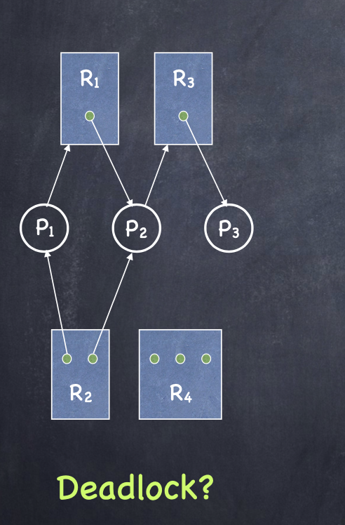
Example 1: RAG Reduction
CS4410 Operating Systems, Lecture on Deadlock

Slide 34
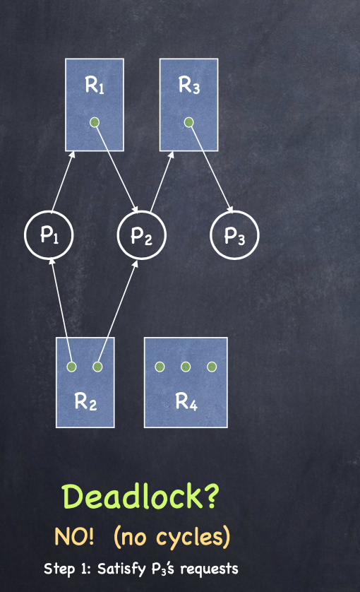
Example 1: RAG Reduction
CS4410 Operating Systems, Lecture on Deadlock

Slide 35
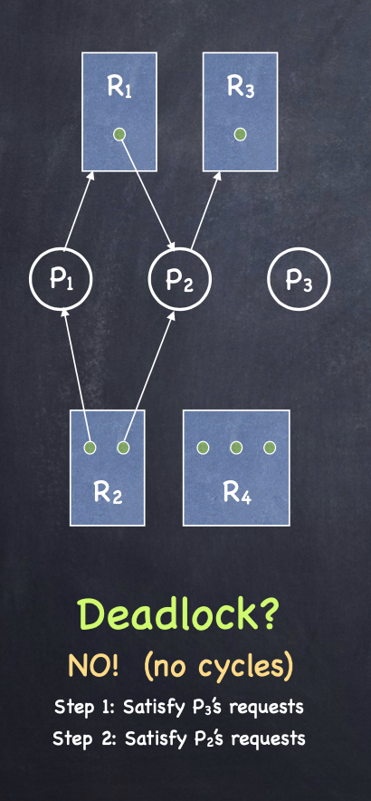
Example 1: RAG Reduction
CS4410 Operating Systems, Lecture on Deadlock

Slide 36
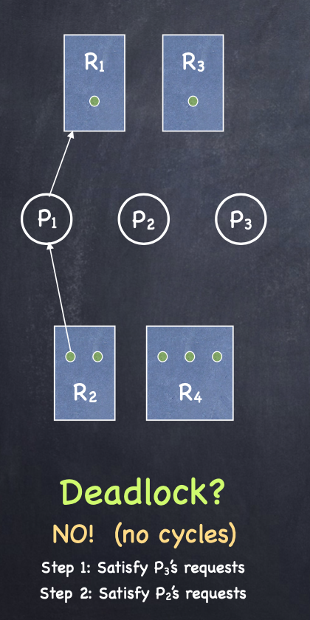
Example 1: RAG Reduction
CS4410 Operating Systems, Lecture on Deadlock

Slide 37
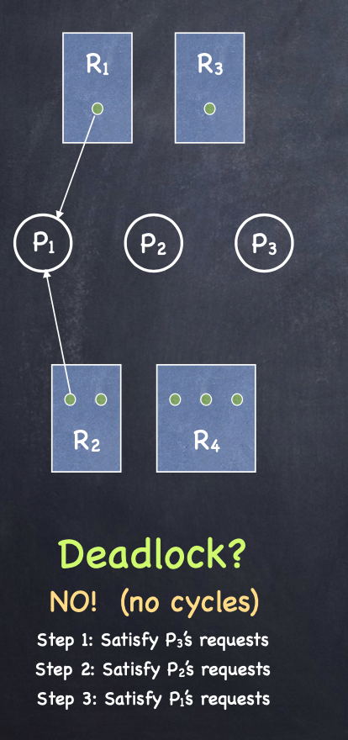
Example 1: RAG Reduction
CS4410 Operating Systems, Lecture on Deadlock

Slide 38
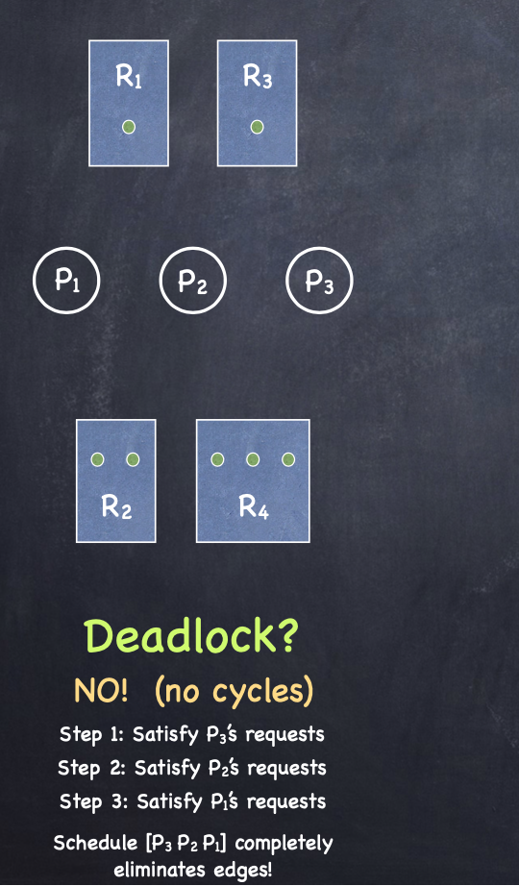
Example 1: RAG Reduction
CS4410 Operating Systems, Lecture on Deadlock

Slide 39
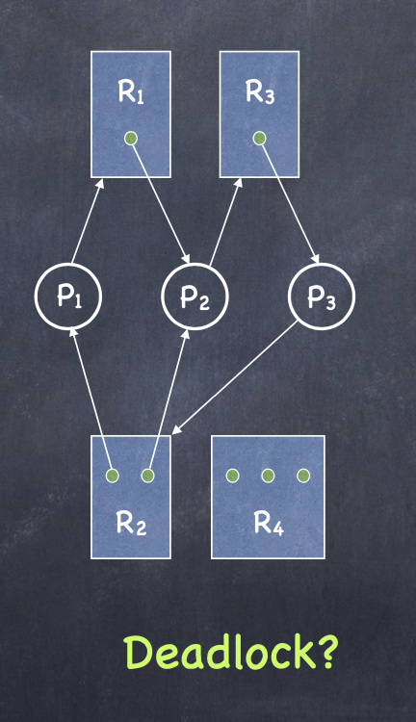
Example 2: RAG Reduction
CS4410 Operating Systems, Lecture on Deadlock

Slide 40
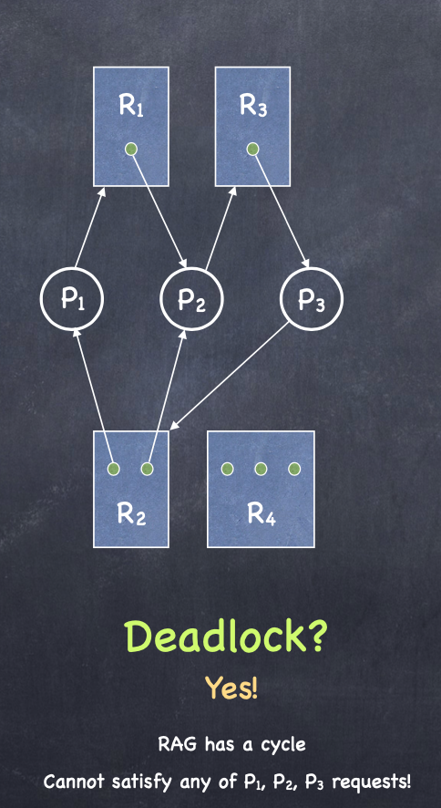
Example 2: RAG Reduction
CS4410 Operating Systems, Lecture on Deadlock

Slide 41
Deadlock can be deadly!
Does a deadlock disappear on it’s own?

Slide 42
Lecture Summary
Starvation vs. Deadlock
Starvation: thread waits indefinitely
Deadlock: circular waiting for resources
Four conditions for deadlocks
Bounded Resources
Hold and wait
Thread holding at least one resource is waiting to acquire additional resources held by other threads
No preemption
Resources are released only voluntarily by the threads
Circular waiting
∃ set {T₁, …, T_{n}} of threads with a cyclic waiting pattern
Next class: Techniques for addressing deadlocks

Slide 43
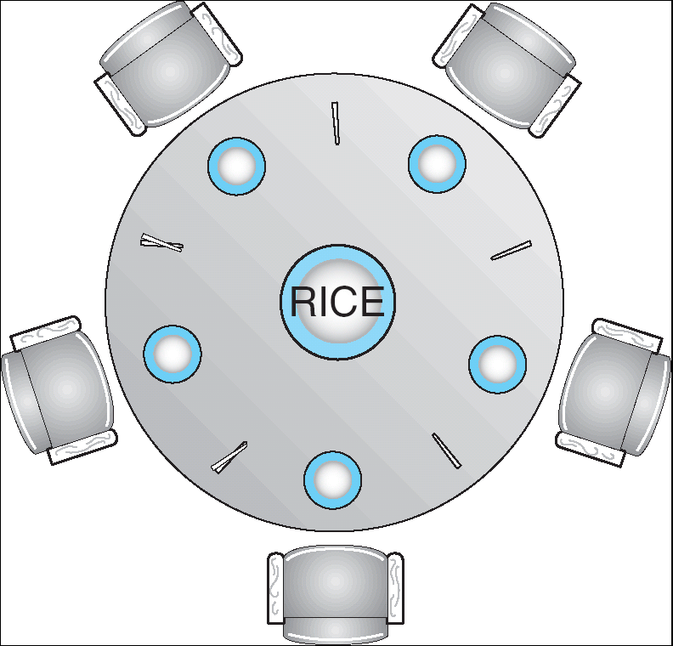
The Dining Philosophers Problem
Five chopsticks, five philosophers
Goal: Grab two chopsticks to eat
Deadlock if they all grab chopstick to their right
How to fix deadlock?
Make one of them give up a chopstick
How to prevent deadlock?
Never take last chopstick if no hungry lawyer has two afterward

